Slide 1

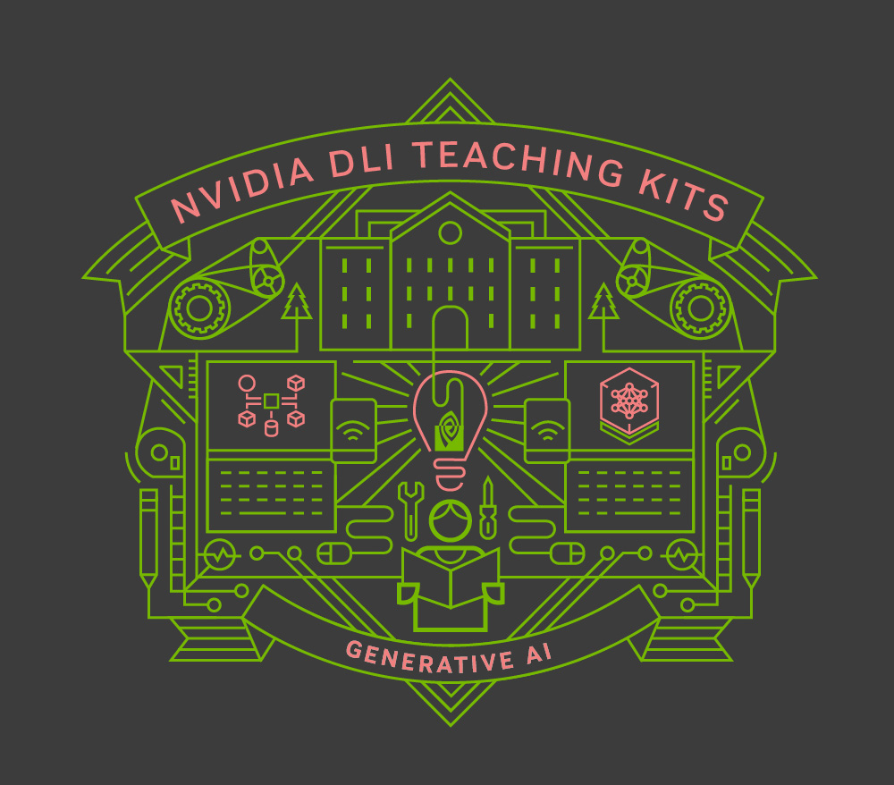
Lecture 1.1 – Introduction to the Generative AI Course
Generative AI Teaching Kit

Slide 2

The NVIDIA Deep Learning Institute Generative AI Teaching Kit is licensed by NVIDIA and Dartmouth College under the
Creative Commons Attribution-NonCommercial 4.0 International License.

Slide 3
Course Structure

Slide 4
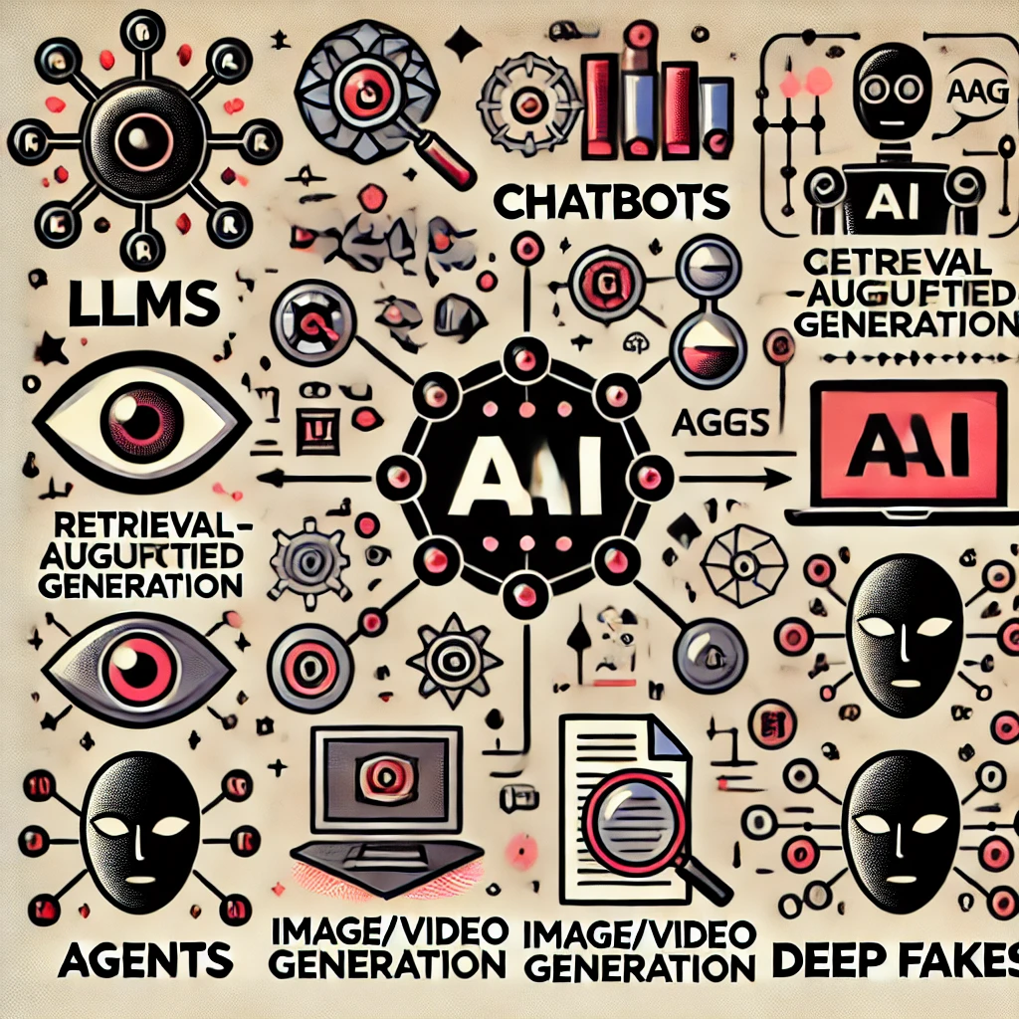
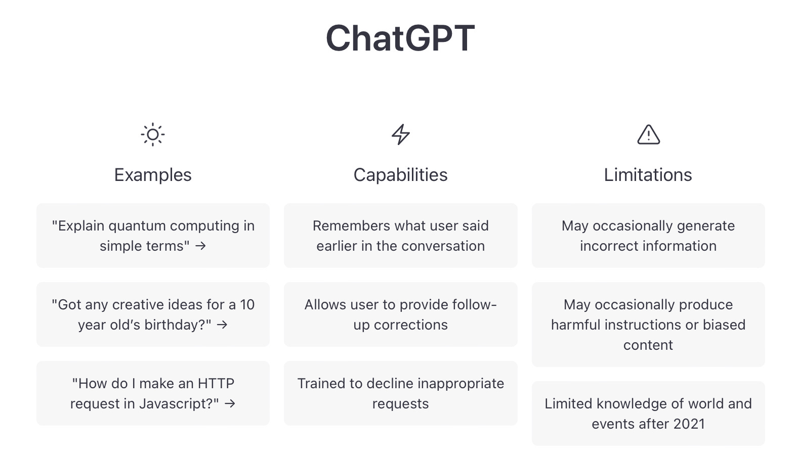
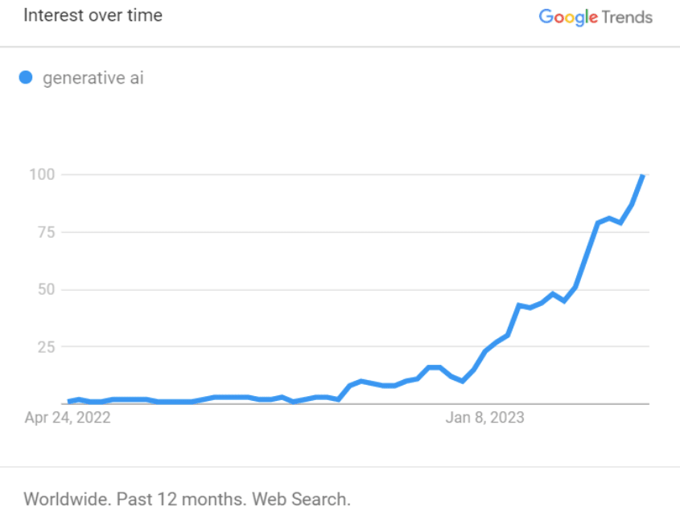
Motivation for this course
Over the last two years you’ve probably hear all of these GenAI buzzwords:
LLMs
Chatbots
RAG
Agents
Image/Video generation
Deep Fakes
Notes:
https://www.coveo.com/blog/is-your-organization-ready-for-generative-ai/
https://biblioracle.substack.com/p/chatgpt-cant-kill-anything-worth

Slide 5
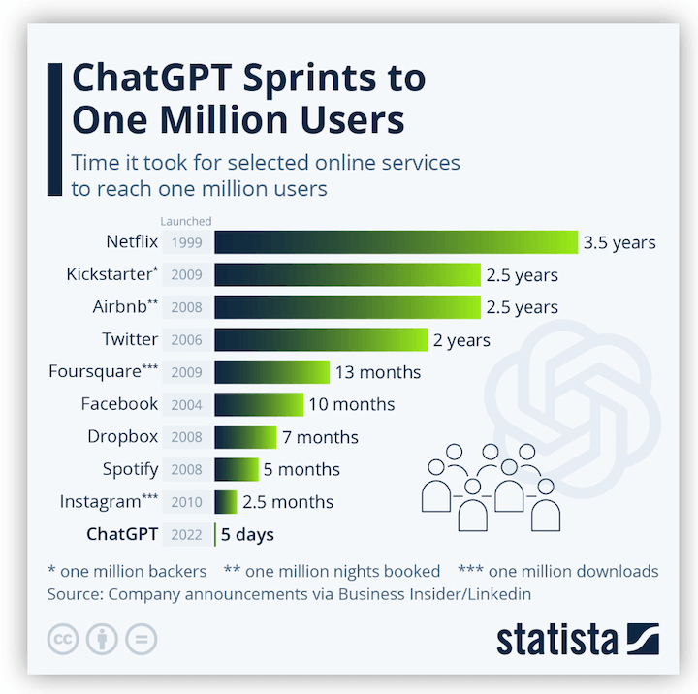
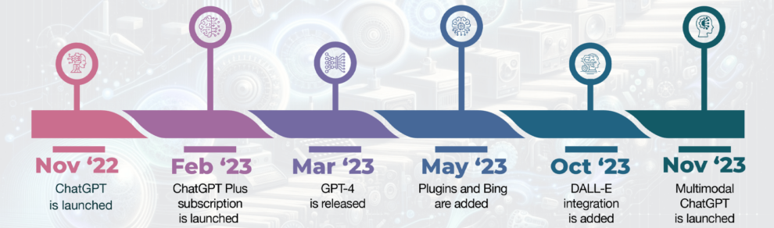
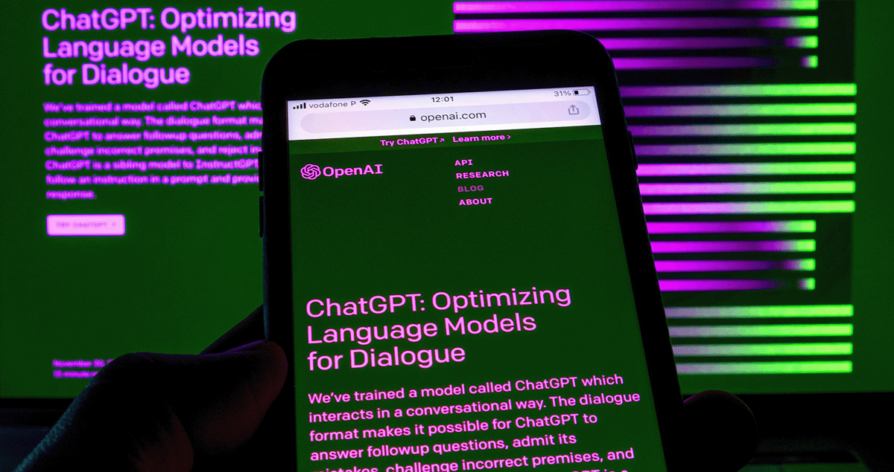
Motivation for this course
ChatGPT Changed the world of knowledge forever
Released Nov 2022 Took the world by storm
How does it know so much?
Is it “thinking” ?
What is it made of?
Notes:
https://builtin.com/artificial-intelligence/what-is-chatgpt
https://www.wordstream.com/blog/ws/2023/03/06/how-to-use-chatgpt-for-small-business-marketing
https://www.twipemobile.com/10-years-of-ledition-du-soir-how-gen-z-use-ai-growing-local-news-websites-twipes-weekly-news-digest/

Slide 6
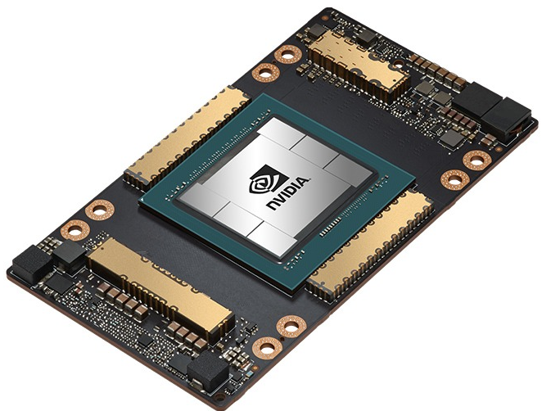
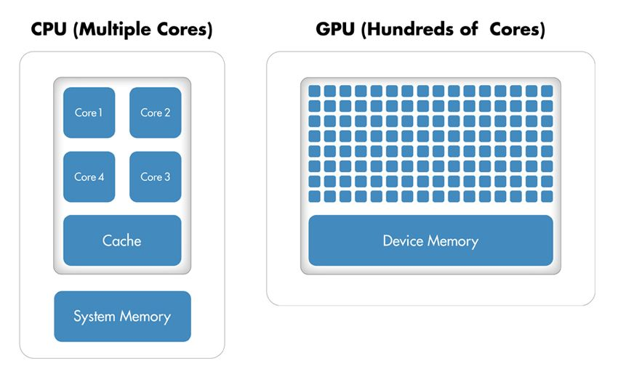
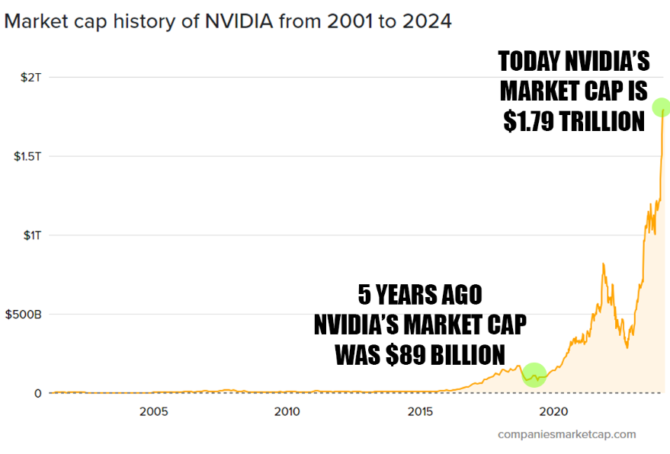
Motivation for this course
In 2024, NVIDIA’s market cap reached 3T! Why?
Why are GPUs are now the hottest commodity for GenAI ?
Notes:
https://www.nvidia.com/en-us/data-center/a100/
https://twitter.com/Benzinga/status/1759952178708451736
https://la.mathworks.com/company/technical-articles/gpu-programming-in-matlab.html

Slide 7
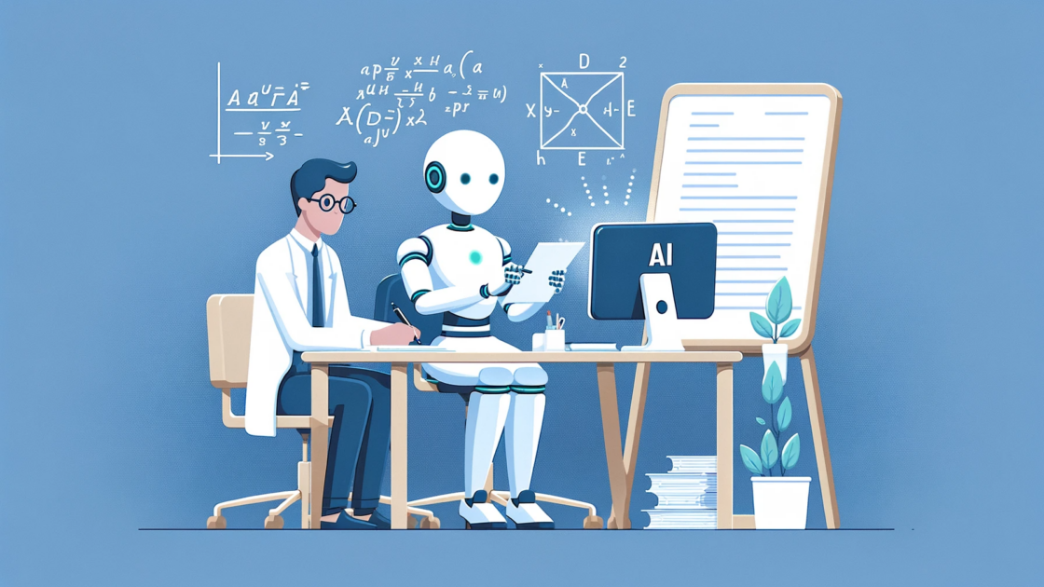
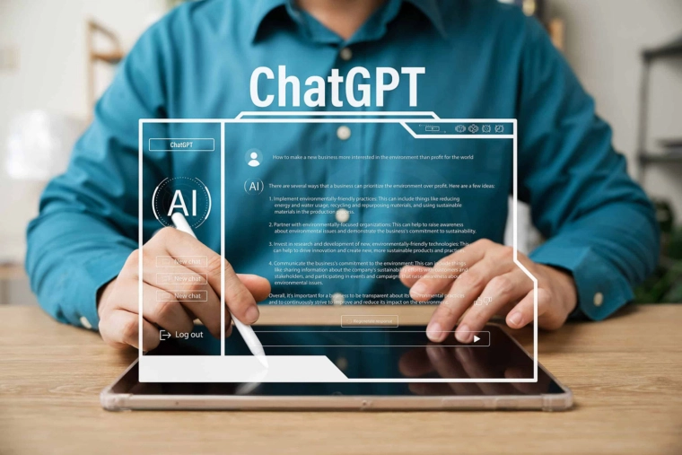
Motivation for this course
GenAI poses a challenge for Academia
Pace of development has far outpaced adoption in schooling
How do we do teaching given these extremely knowledgeable, highly accessible tools?
Familiarity with the abilities and limits of these tools is vital to maintain competitiveness for both teachers and students
Notes:
https://ecrcommunity.plos.org/2024/01/13/the-academic-ai-takeover-how-to-embrace-the-ai-revolution/
https://www.lib.pacificu.edu/navigating-the-future-the-role-of-ai-in-academic-libraries/

Slide 8
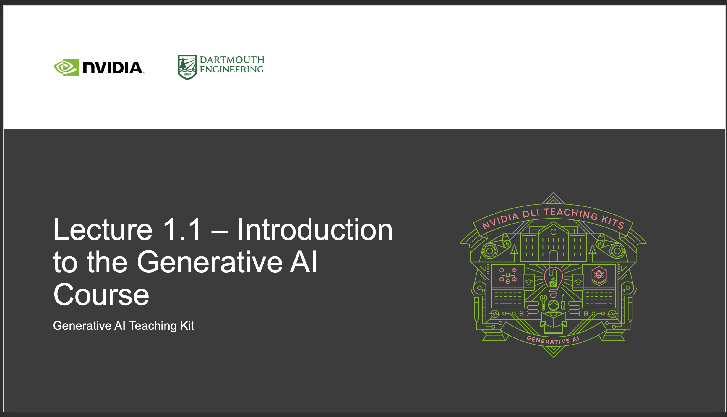
Structure of the course
How each module of the course is designed
Online Syllabus
Lays out entire course including planned future content
Lecture Slides
Introduce content
Demo Notebooks
Show the tools in practice
Knowledge Checks
Keeping track of the content
Lab Notebooks
Your turn to build with the tools
DLI Online Courses
Online, self-paced courses offering certificate

Slide 9
Structure of the course
Lecture Slides
2 or three lectures per module
Designed to introduce the necessary information needed to understand what/how things work
Not deep mathematical proofs, more applied science/engineering focus

Slide 10
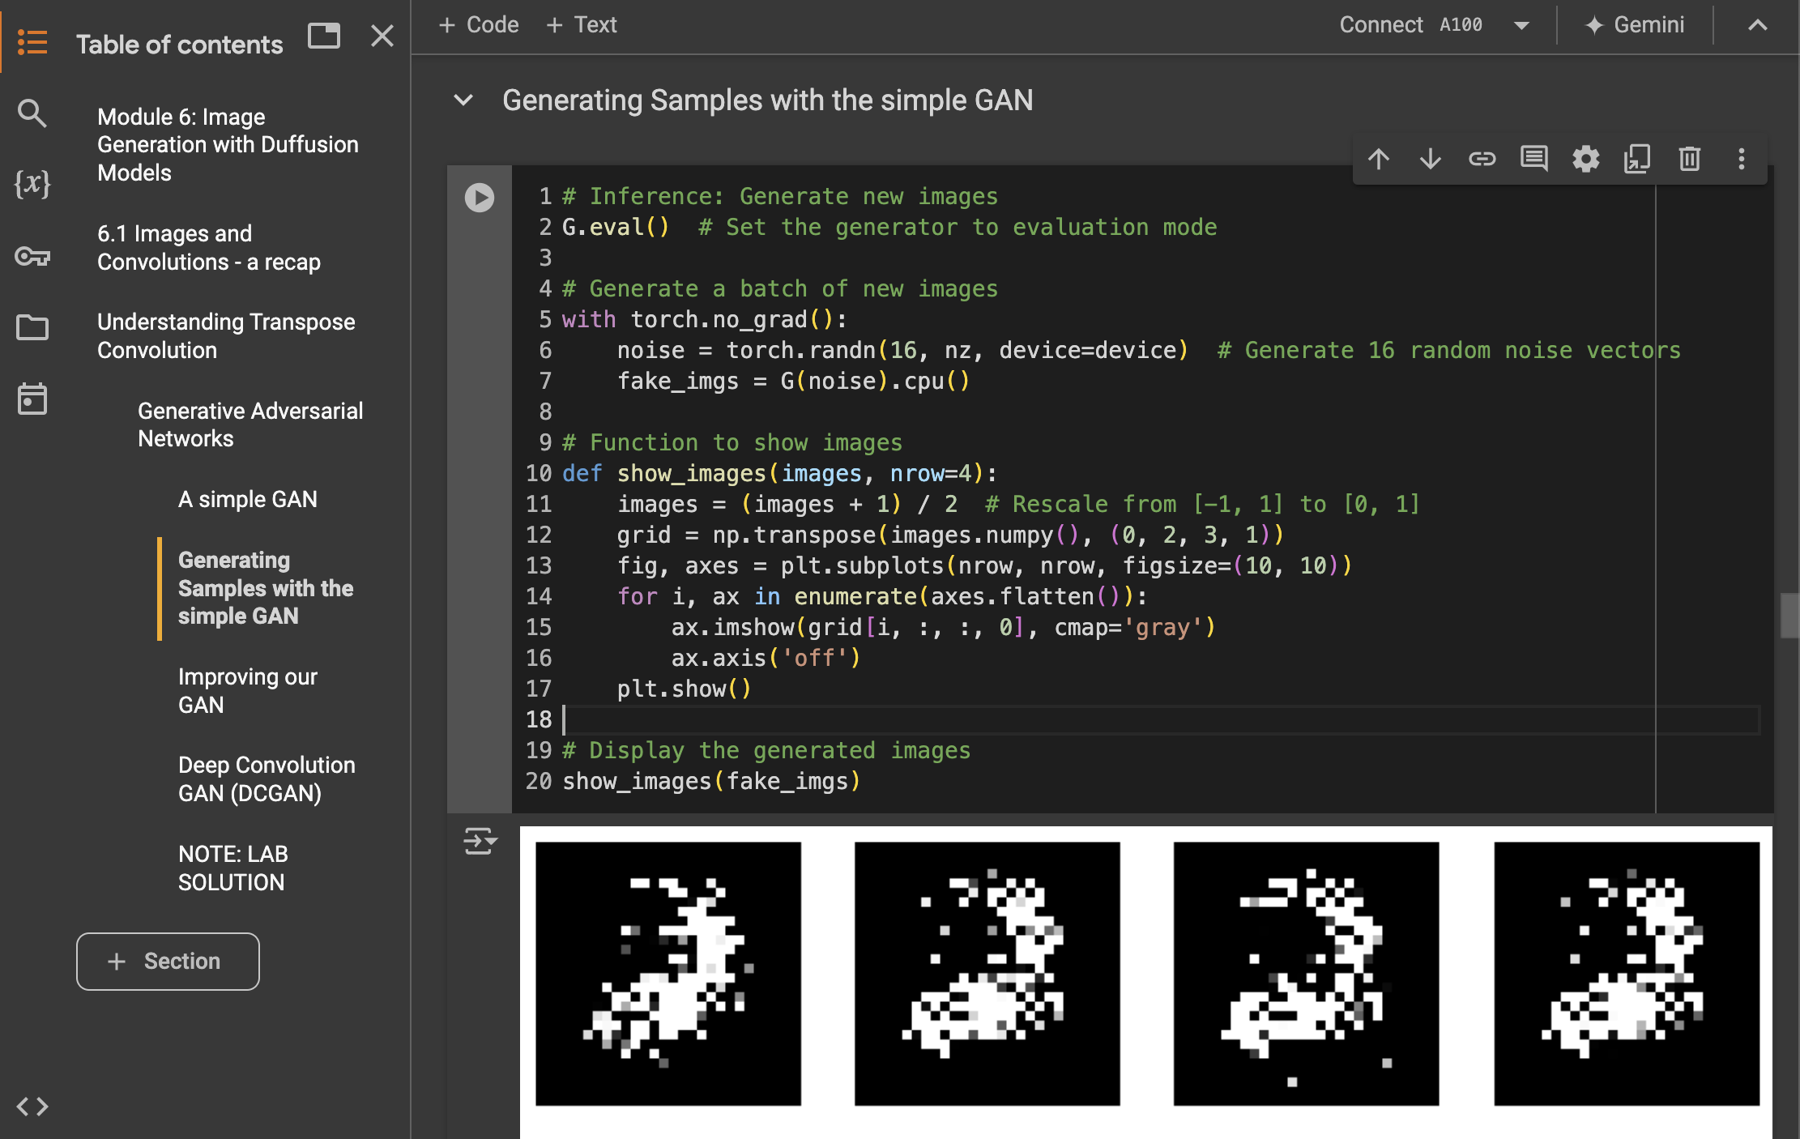
Structure of the course
Demo Notebooks
Designed to be used during class time for the instructor to show how these tools/topics can work
Built with an interactive Python notebook, namely Google Colab

Slide 11
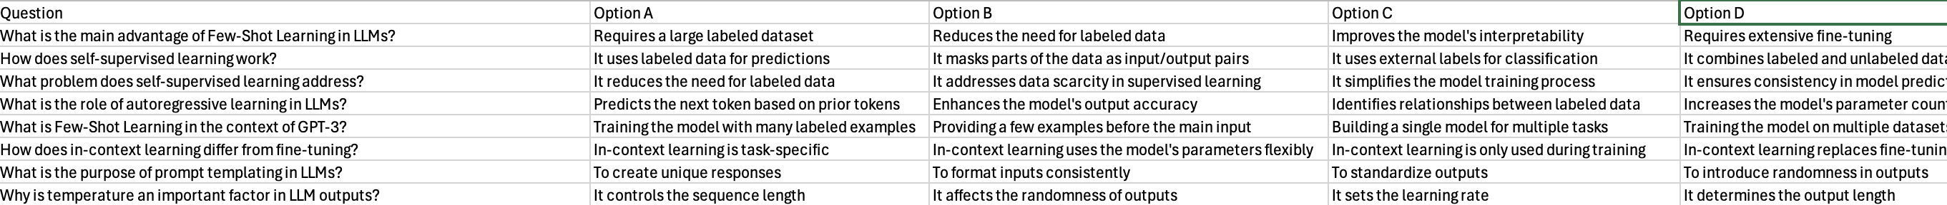
Structure of the course
Knowledge Checks
Confirmation of the development of a working knowledge of GenAI topics

Slide 12
Structure of the course
Lab Notebooks
Based on the demo notebooks
These will give you the chance to implement the tools and explore the topics covered in each module

Slide 13

Structure of the course
DLI Online Courses
Related self-contained, self-paced DLI courses
Free for students using promo codes provided
Runs on DLI Platform instead of Colab
Offers student certificates of competency based on built-in assessments

Slide 14
Tools used in GenAI

Slide 15
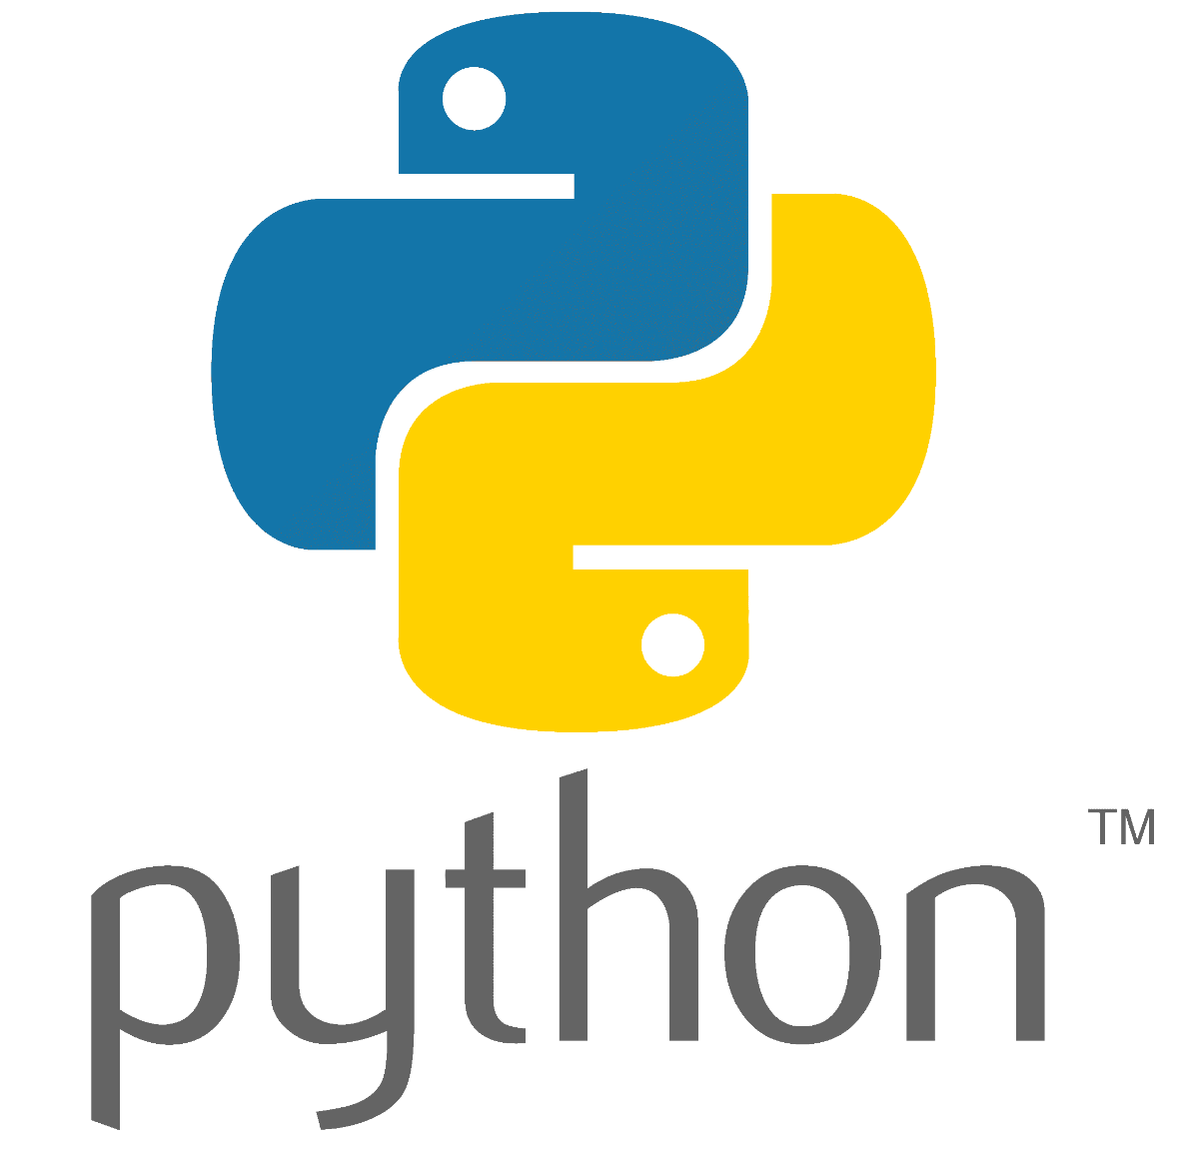
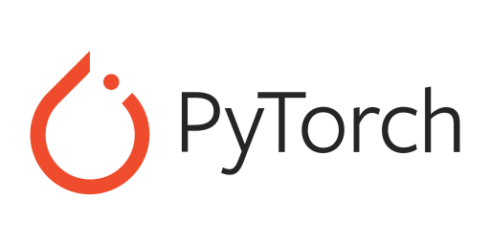

GenAI Tools in this Course
Python is the most widely used language in the AI/ML community, making it the go-to language for developing Generative AI models.
Python’s simple syntax and readability allow developers and researchers to quickly prototype and implement complex algorithms.
TensorFlow & PyTorch: Essential for building and training deep learning models, which are at the core of GenAI.
Hugging Face Transformers: A popular library for working with large language models (LLMs), crucial for tasks like text generation and RAG.
OpenCV & PIL: Important for image and video manipulation in GenAI applications like deep fakes and image generation

Slide 16
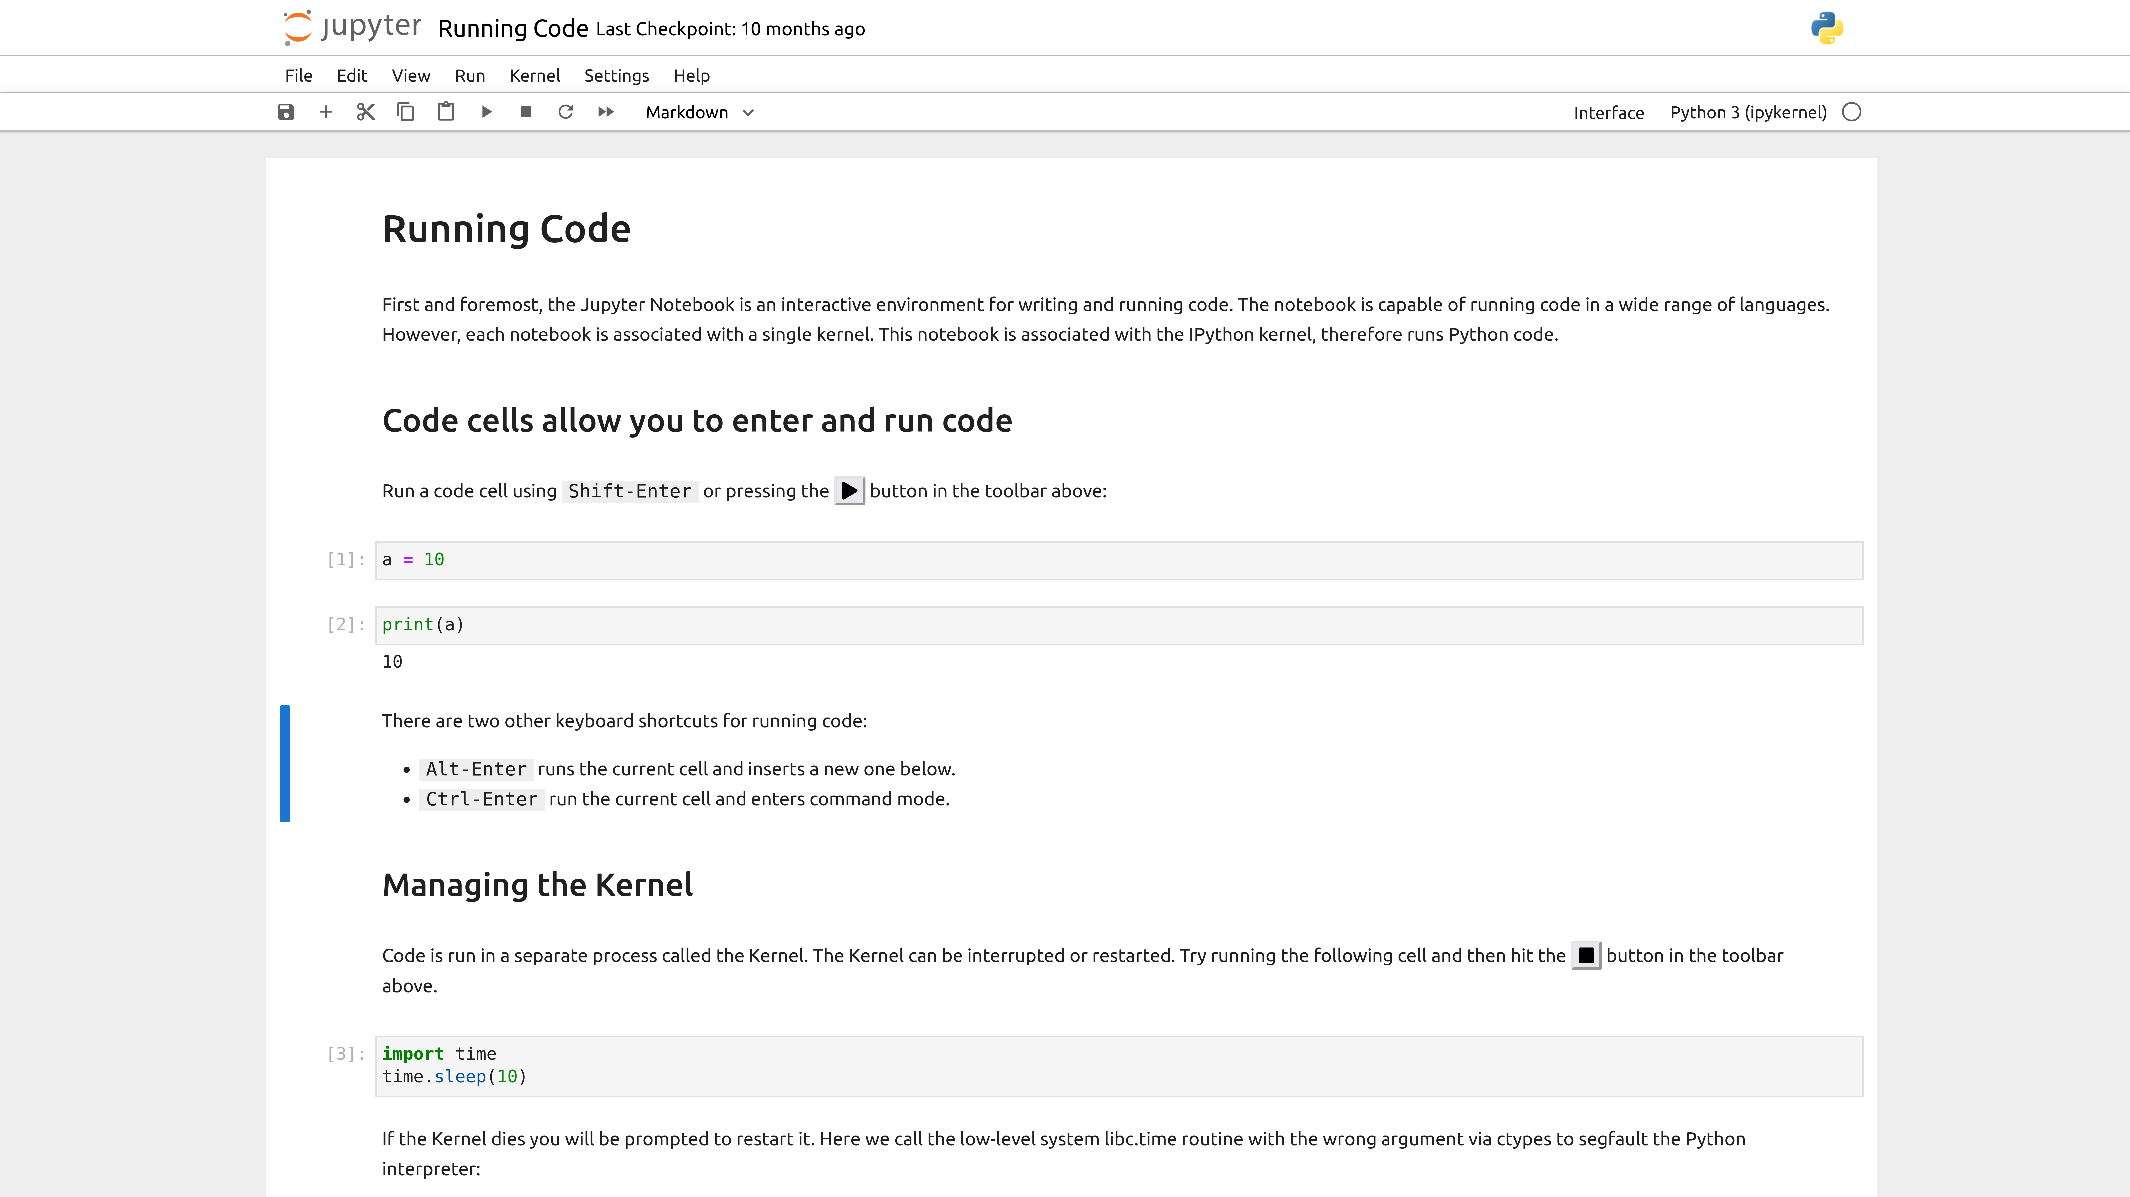

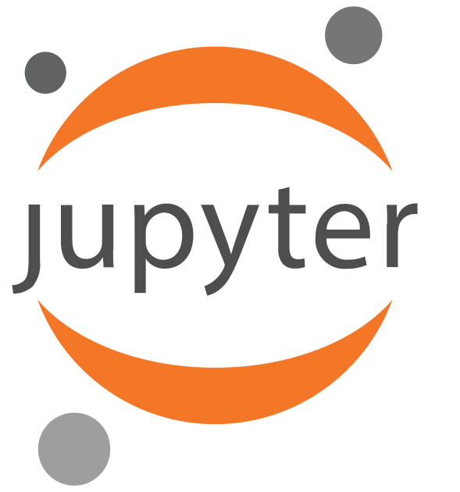

GenAI Tools in this Course
Coding Notebooks
The primary platform to work with these AI tools and code libraries will be through the Google Colab notebooks
These notebooks allow for easy interaction with the data and models in a visual manner
Platforms like Google Colab and other cloud notebook providers also supply access to cloud-based GPUs and compute infrastructure.

Slide 17
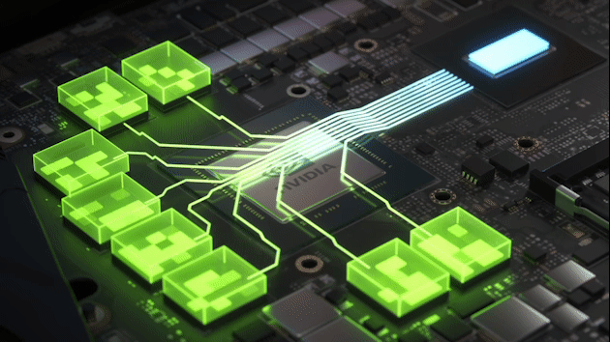
GenAI Tools in this Course
The Importance of GPUs in GenAI
Parallelism: GPUs have thousands of cores optimized for parallel processing, allowing them to handle many operations at once. This is essential for the matrix multiplications and other computations involved in AI inference.
Throughput: GPUs can process large batches of data simultaneously, which is critical for applications like image generation or video synthesis where high throughput is needed.
Latency: GPUs reduce latency by executing multiple operations in parallel, which speeds up the time it takes to get from input to output in GenAI models.
Notes:
https://images.frandroid.com/wp-content/uploads/2021/02/nvidia.gif

Slide 18
Course Content

Slide 19
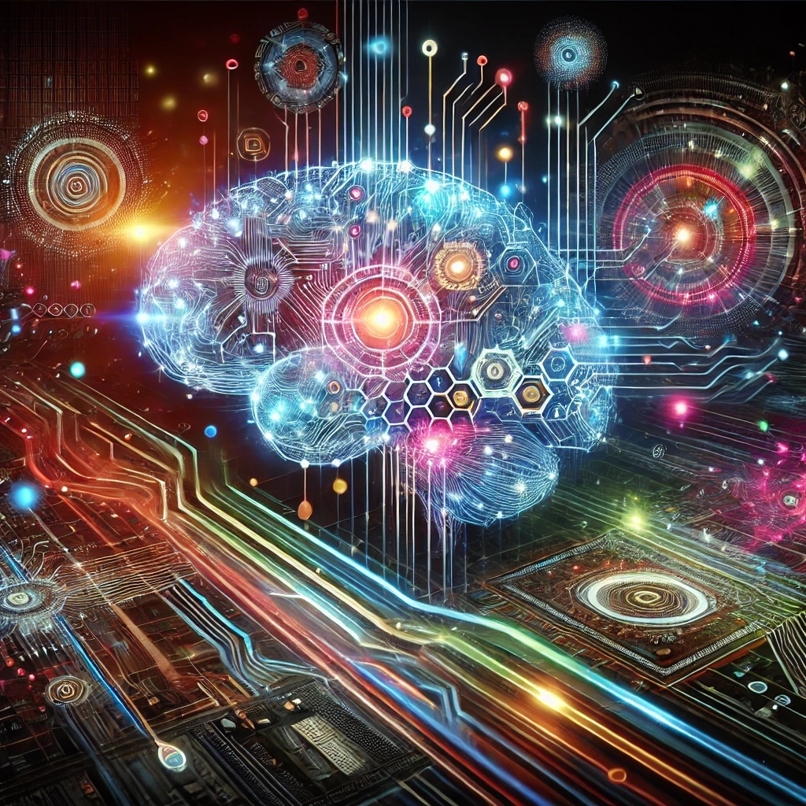
What this course will cover
Modules
Introduction to Generative AI
Word Embeddings, Tokens, and NLP
Large Language Models and the Transformer
LLM Scaling Laws and LLM Families
Multimodal Learning and its Applocations
Diffusion Models in Generative AI
Model Training (Pre-Training, Instruction Following, and PEFT)
LLM Orchestration
Scaling Model Training to Distributed Workloads
Full online syllabus

Slide 20
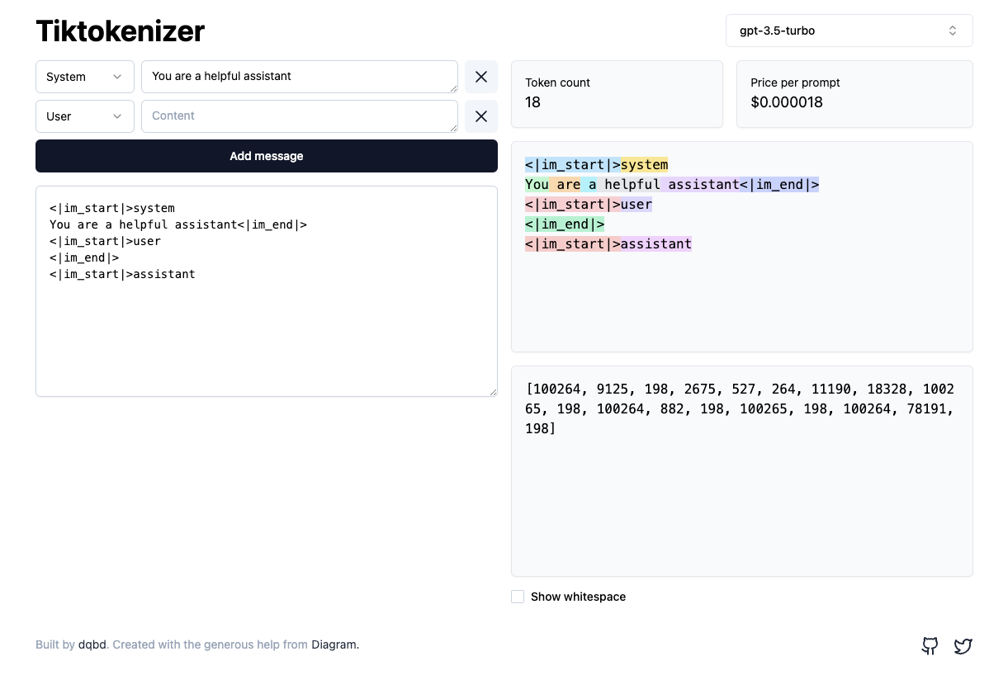
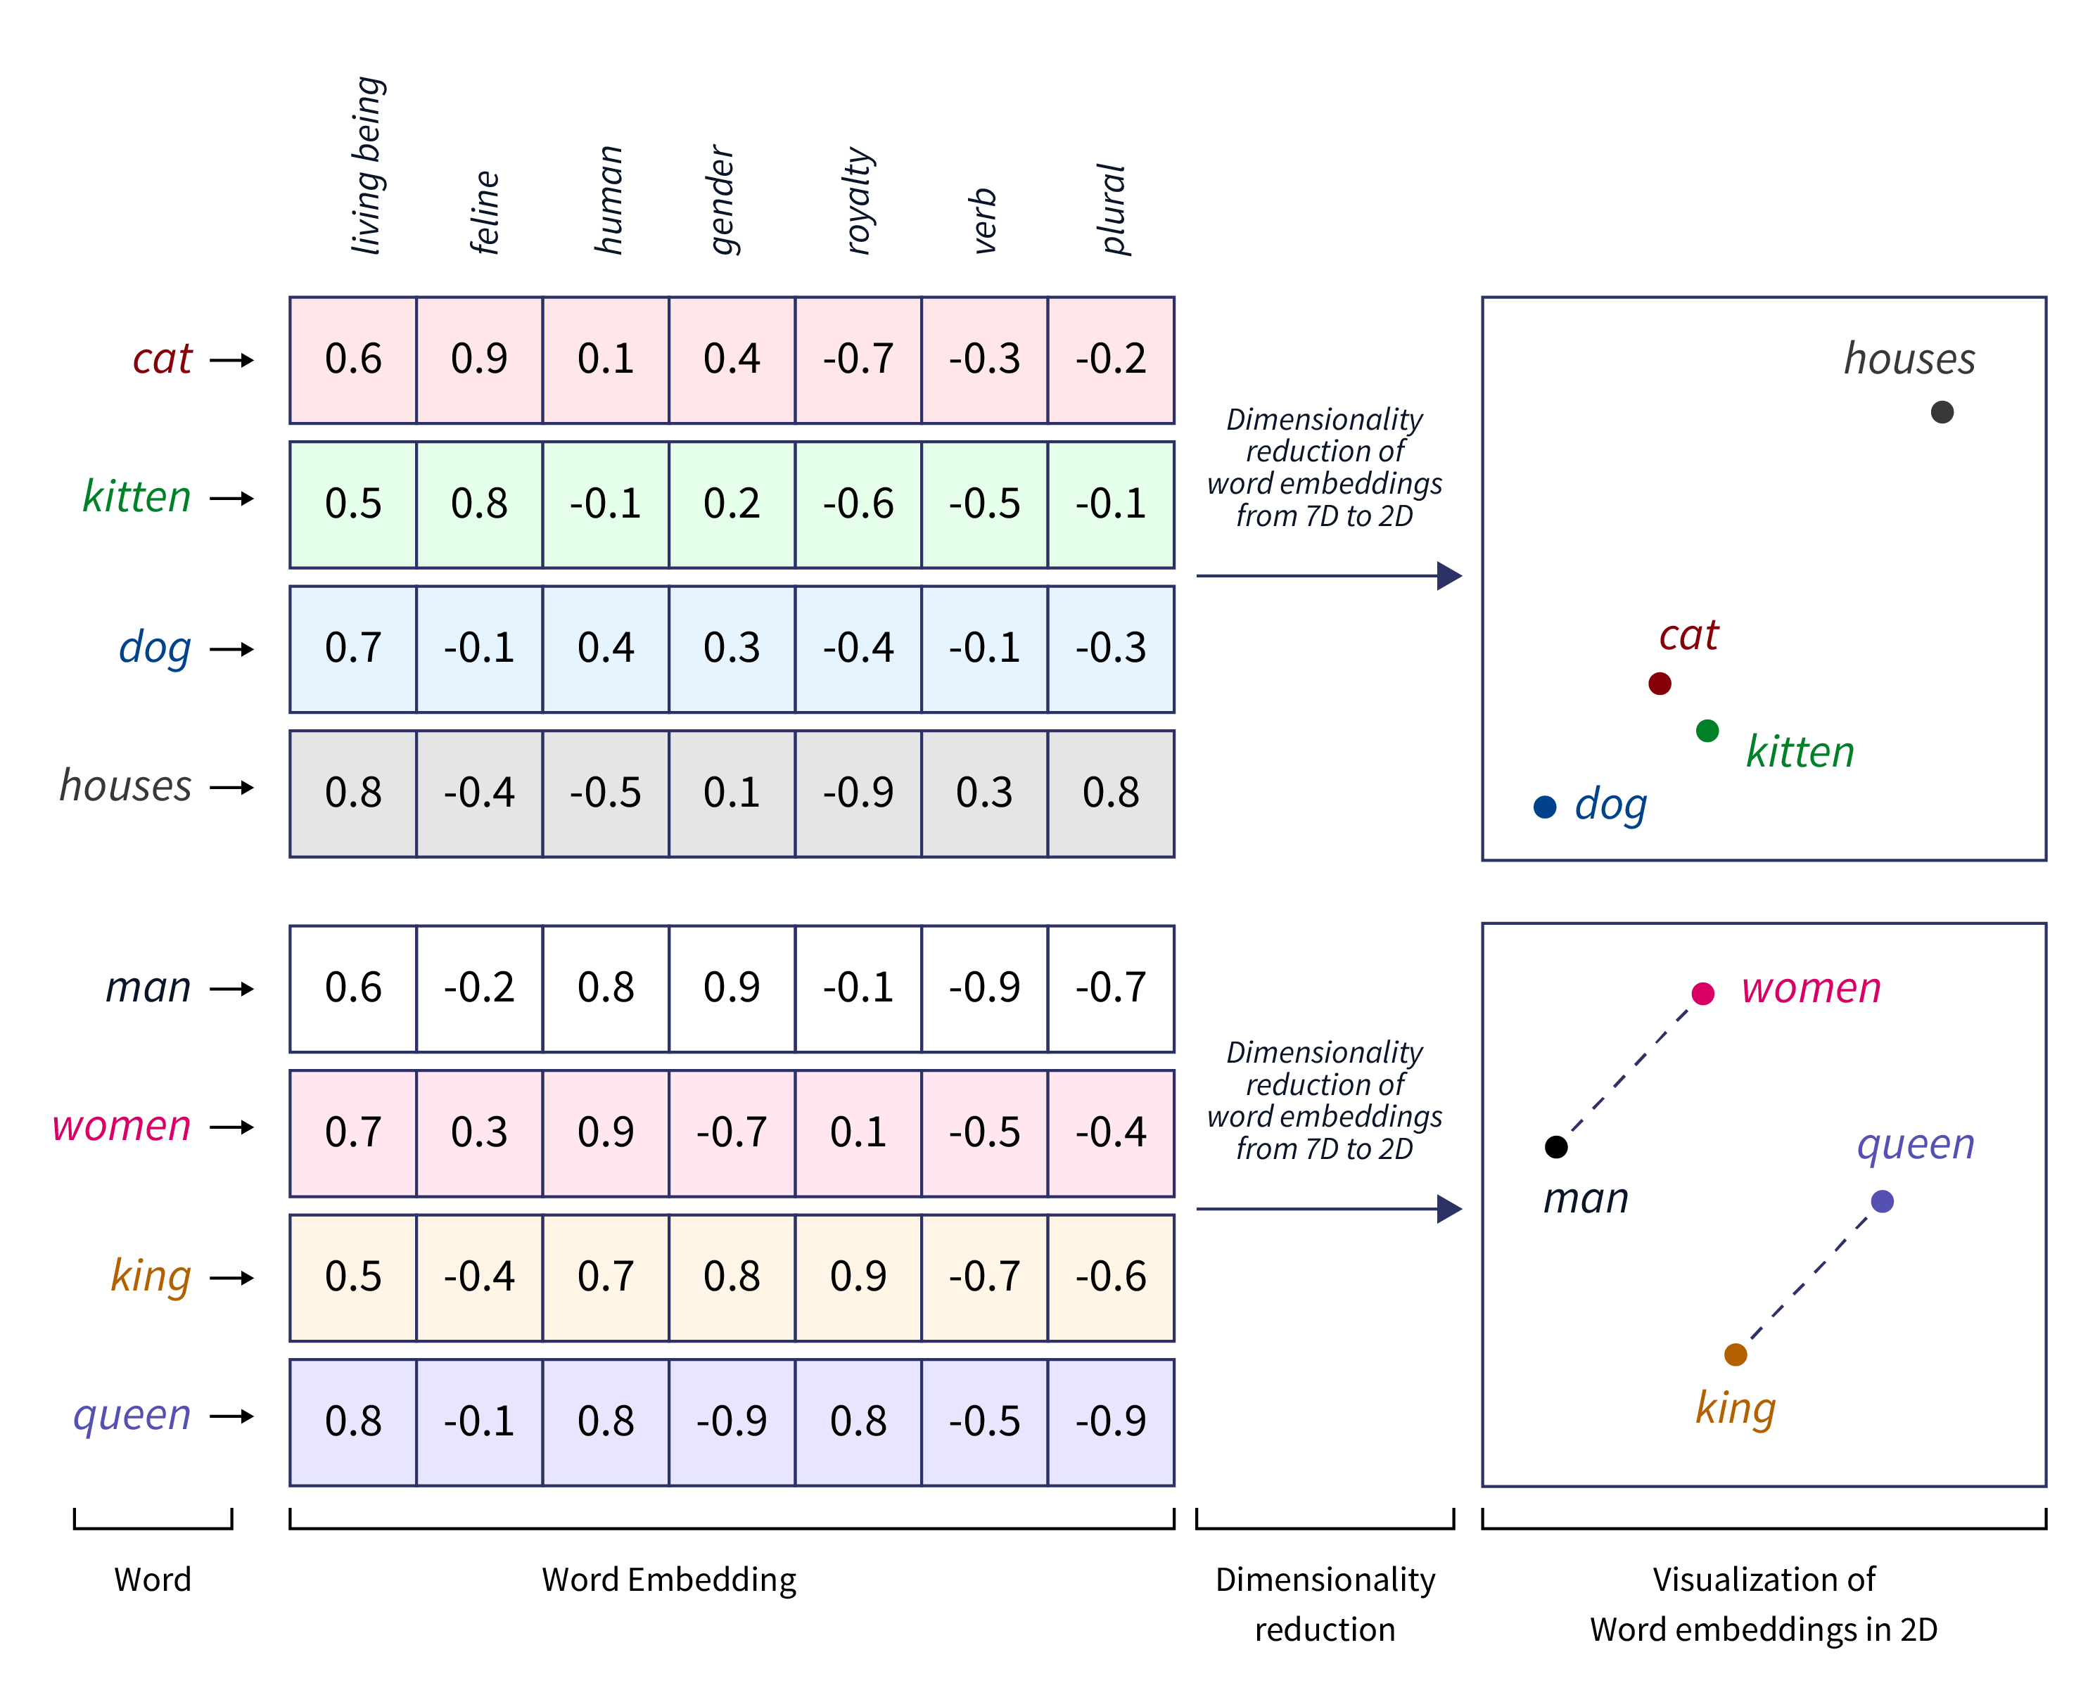
2. Word Embeddings, Tokens, and NLP
Notes:
https://www.scaler.com/topics/tensorflow/tensorflow-word-embeddings/
https://christophergs.com/blog/understanding-llm-tokenization

Slide 21
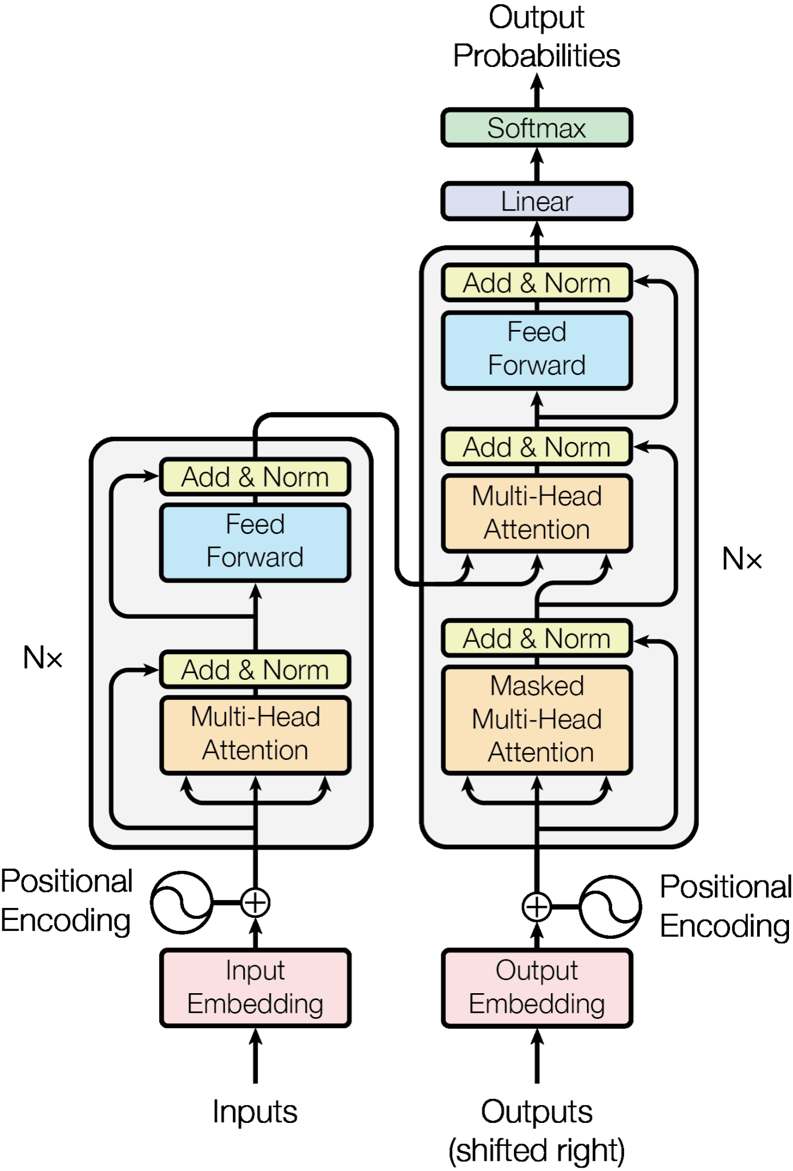
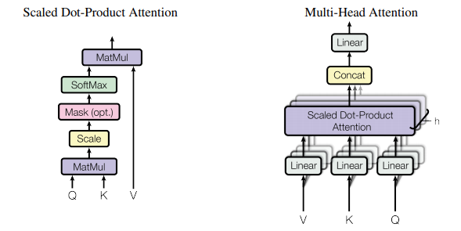
3. Large Language Models and the Transformer
Notes:
https://cdn.prod.website-files.com/62c4a9809a85693c49c4674f/6580badb5a5031ccde99abac_transformer-model.png
https://vaclavkosar.com/images/expire-span-attention-recap.png

Slide 22
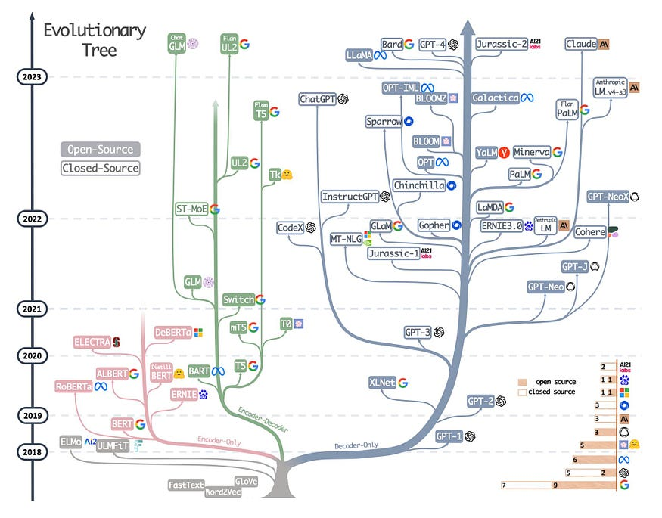
4. LLM Scaling Laws and LLM Families
Notes:
https://www.yadavsaurabh.com/transformer-llm-series-decoding-the-intelligence/

Slide 23
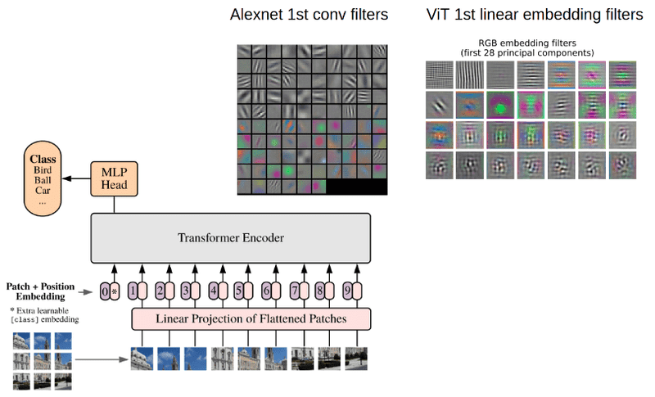
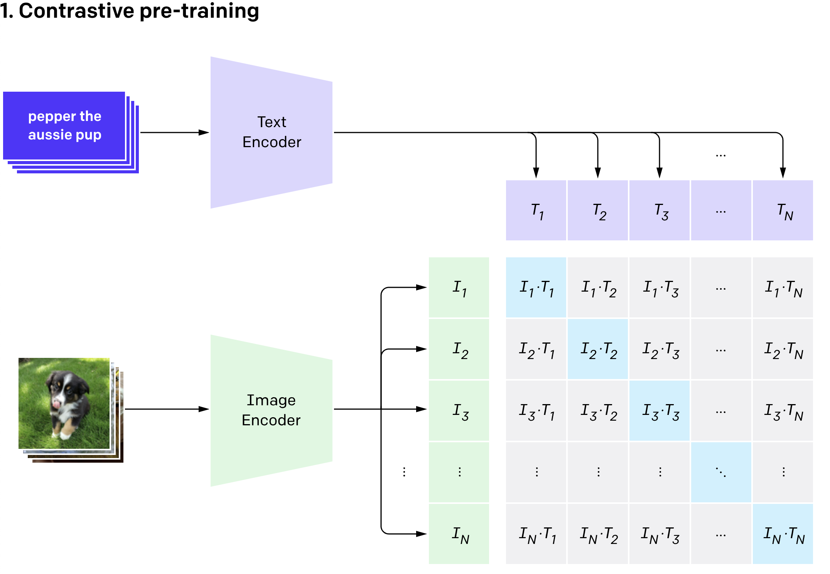
5. Multimodal Learning and its Applications
Notes:
https://openai.com/index/clip/
https://theaisummer.com/vision-transformer/

Slide 24
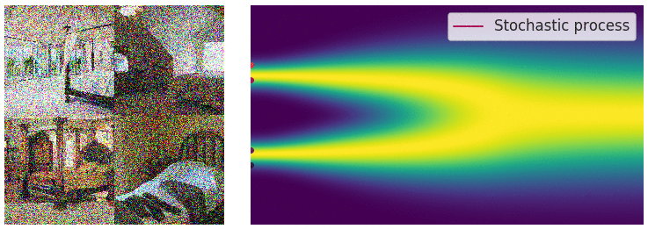
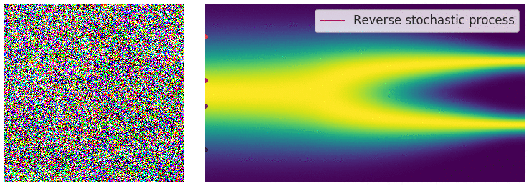
6. Diffusion Models in Generative AI
Notes:
https://aaronlou.com/blog/2023/reflected-diffusion/

Slide 25
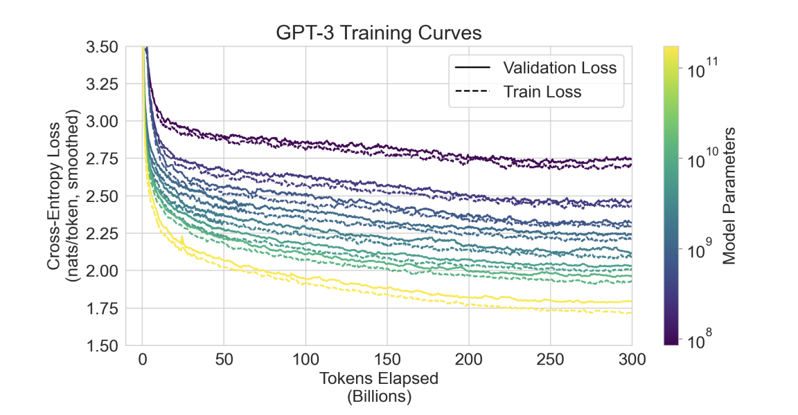
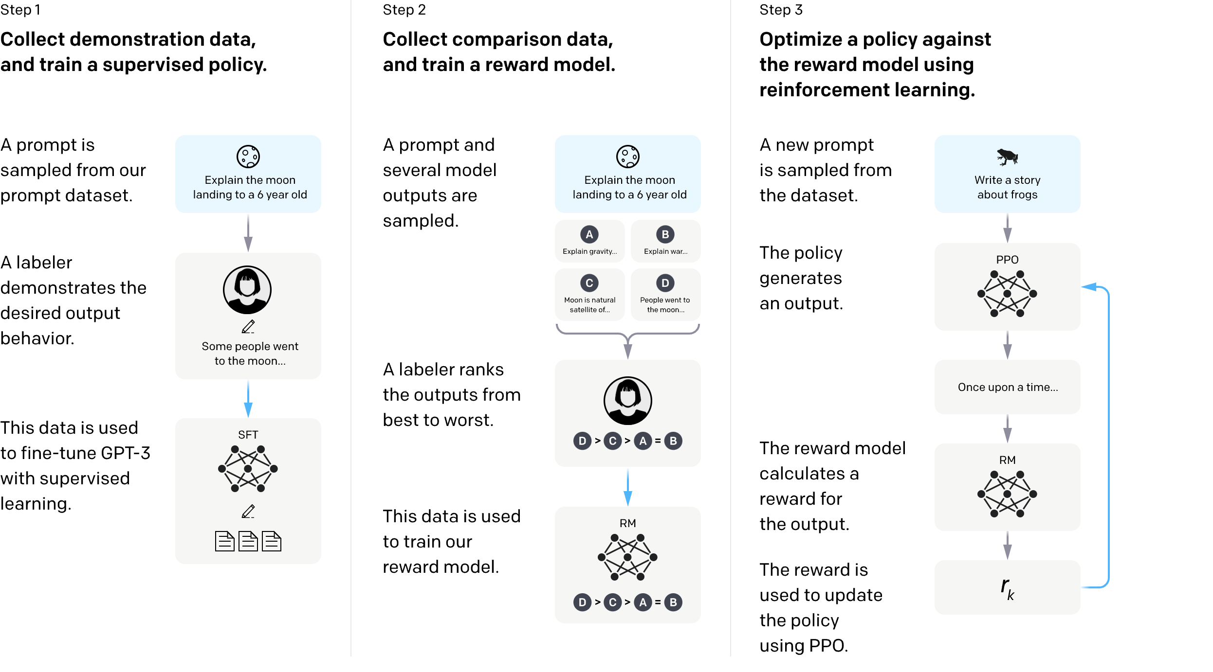
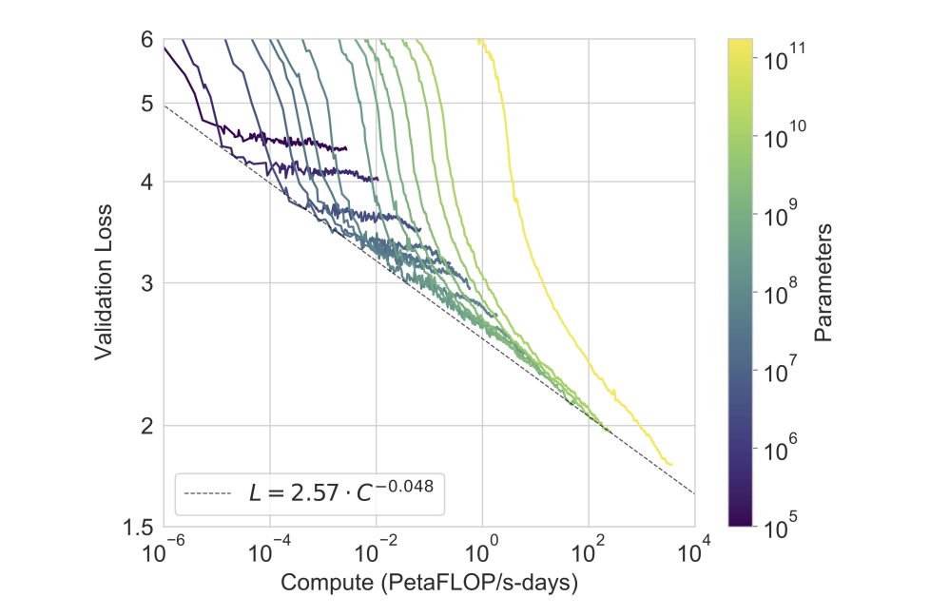
7. Model Training (Pre-Training, Instruction Following, and PEFT)
Notes:
https://arxiv.org/pdf/2005.14165
https://media.graphassets.com/0kDmTciaSUy339cX7hsT

Slide 26
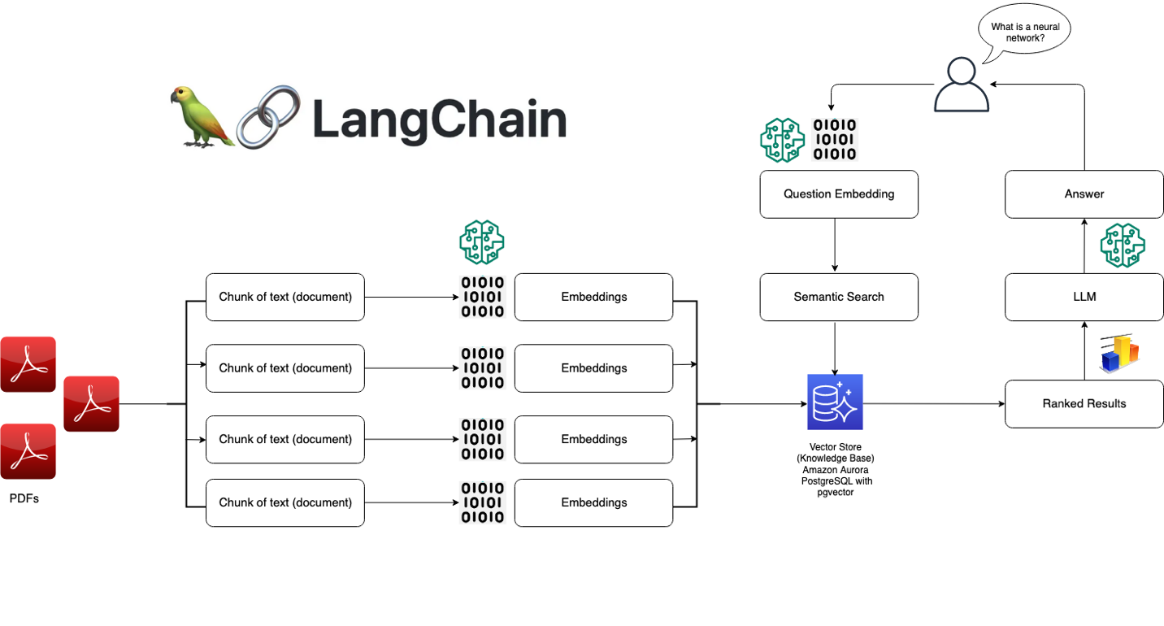
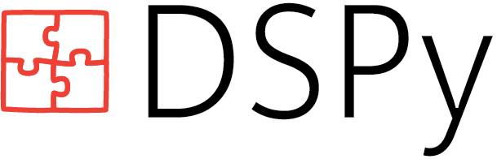
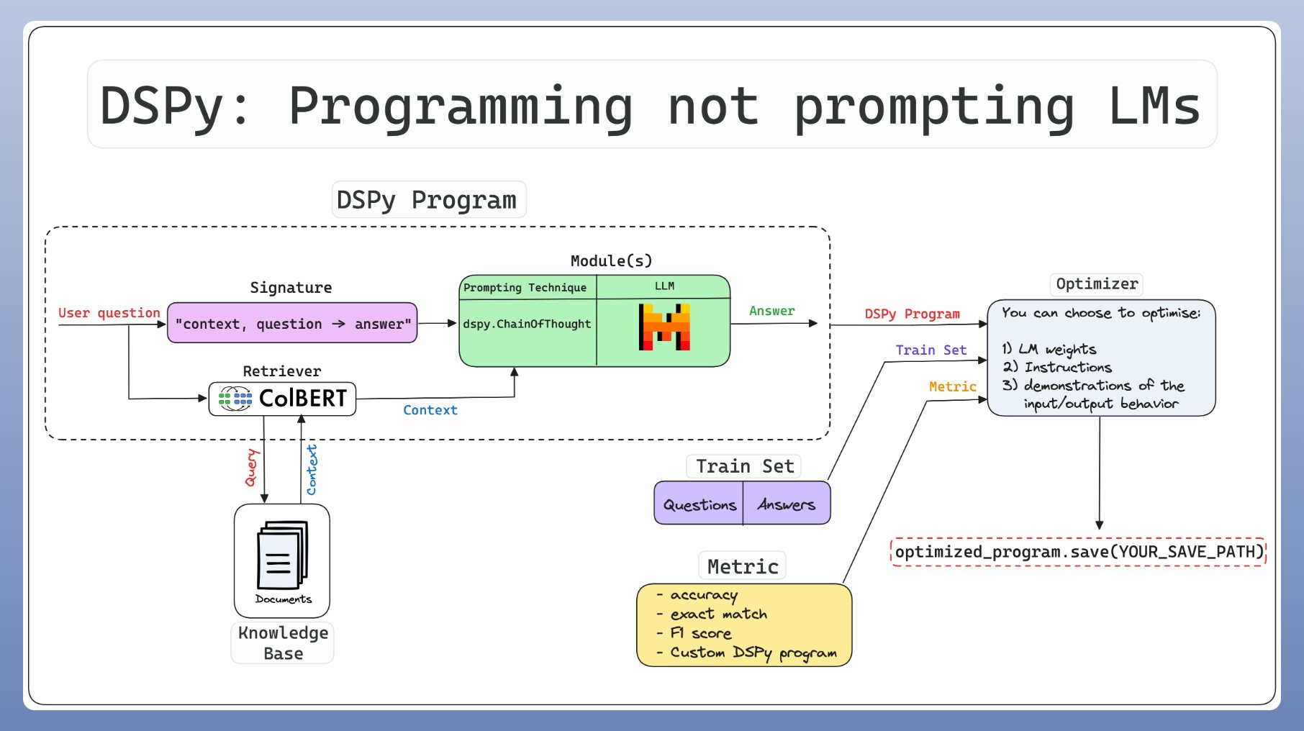
8. LLM Orchestration
Notes:
https://aws.amazon.com/what-is/langchain/
https://lightning.ai/lightning-ai/studios/dspy-programming-with-foundation-models

Slide 27
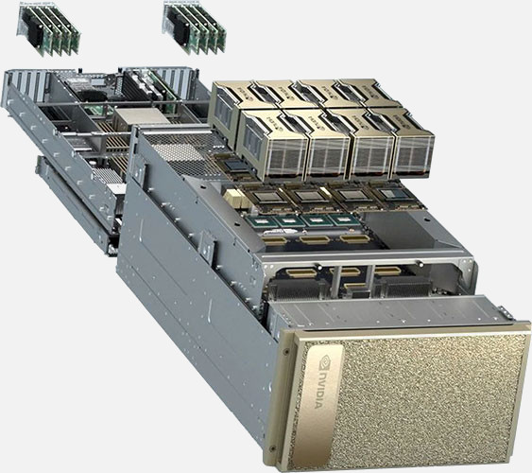
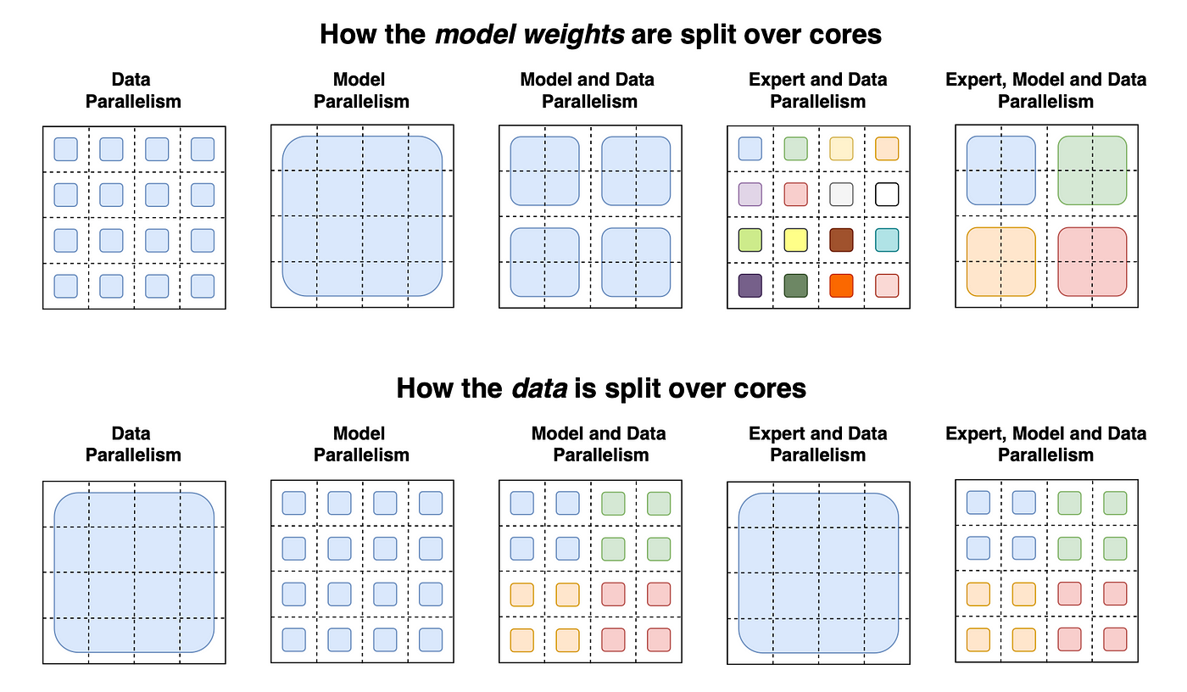
9. Scaling Model Training to Distributed Workloads
Notes:
https://www.broadberry.com/xeon-scalable-processor-gen4-rackmount-servers/nvidia-dgx-h100
https://miro.medium.com/v2/resize:fit:1400/1*OXtkG9ABtfIW-lCBkf5Yxg.png

Slide 28
Wrap Up
Introduction to GenAI
Today we introduced the GenAI Course
We covered the different materials used in the class
Provided an overview of the modules to come
Highlighted how GenAI has exploded onto the scene of science, engineering, and the economy at large
-----------------------------------------------------------------------------
In the next lesson we will start our discussion into how we got to this point and what advances led us from the digital computer, to ChatGPT

Slide 29
Thank you!

